Slide 1

Principles of Web Design 6th Edition
Chapter 1 – HTML5

Slide 2
Objectives
Create web pages with HTML
Add style with CSS
Describe the history of HTML
Work with HTML5
Use good coding practices

Slide 3
Creating Web Pages with HTML
HTML is a markup language that lets you identify common sections of a web page
Markup elements define each section
This <h1> element defines text as a first-level heading:
<h1>What is HTML?</h1>

Slide 4
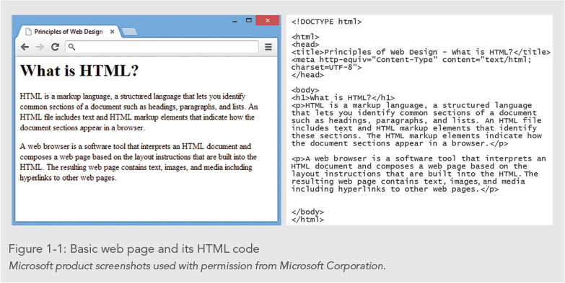

Slide 5
HTML Syntax
Web page code is a mixture of the text the user sees in the browser surrounded by a variety of markup elements
An element is a pair of HTML tags containing content
An HTML tag includes an opening bracket (<), an element name such as h1, and a closing bracket
The end tag has a slash ( / ) preceding the element.

Slide 6
HTML Syntax
Some HTML elements contain only a single tag. These are known as void elements
Void elements insert something onto the page, such as a new line using the <br> element

Slide 7
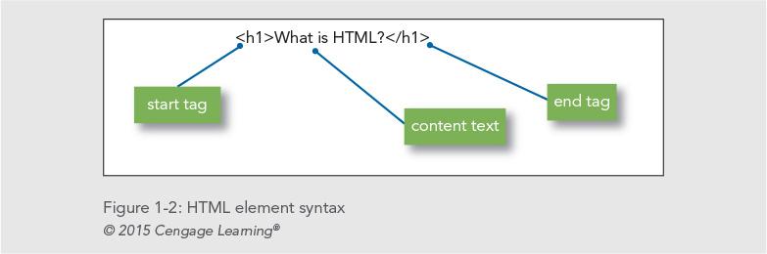
HTML Syntax

Slide 8
HTML Syntax
Some HTML elements support attributes that let you provide more information about an element
Here is an attribute (shown in bold) added to an <h1> element:
<h1 id="maintitle">Main Title of the Document</h1>

Slide 9
Structure of a Basic Web Page
The HTML file contains content text and HTML markup
The HTML markup does not appear in the browser
The browser interprets the code and displays the results

Slide 10
Structure of a Basic Web Page
The document type, or doctype for short, specifies the rules for the document language
The <html> tag is the root element
The two main sections are the <head> and <body> elements
The head section is the container for all of the descriptive information about the document
The <body> section includes the content that the user sees in the browser window

Slide 11
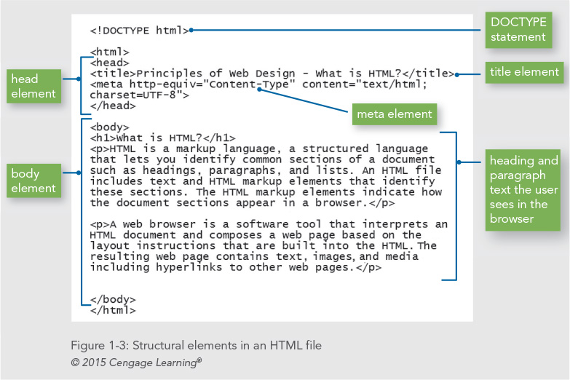

Slide 12
HTML in the Browser
The browser interprets the HTML markup elements and displays the results, hiding the actual markup from the user
Each browser interprets HTML in its own way, based on its rendering engine
It is essential that you test your work in different web browsers

Slide 13
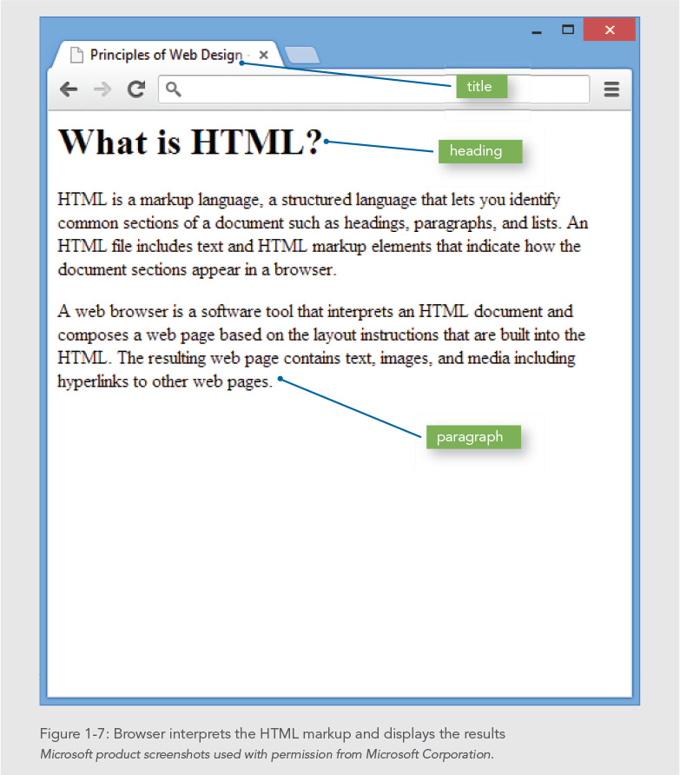

Slide 14
Adding Style with CSS
Web designers use Cascading Style Sheets (CSS) to add presentation information to web pages
With CSS you can display information for different devices
With style sheets, the presentation properties are separate from the content
CSS lets you control the presentation characteristics of an entire web site with a single style sheet

Slide 15
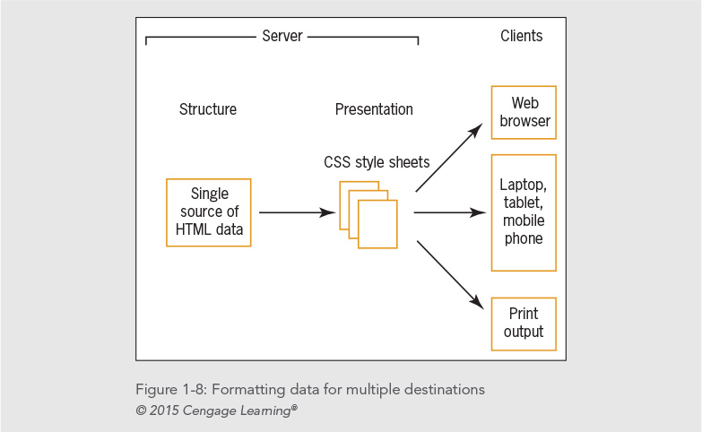

Slide 16
Adding Style with CSS
The next two figures show CSS style rules and the result in the browser
The style rules in Figure 1-9 specify that the body text for the page will be Arial, the h1 will have a bottom border, and the paragraph will have a 30-pixel left margin
Figure 1-10 shows the results in the browser

Slide 17
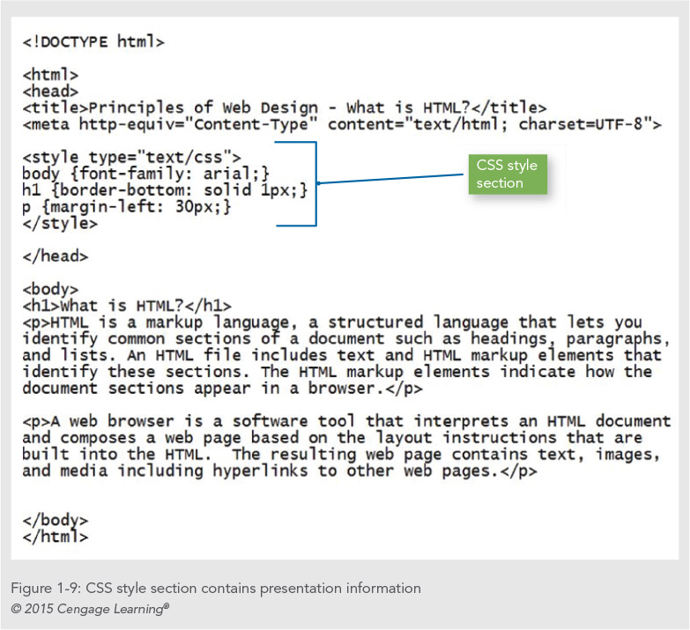

Slide 18
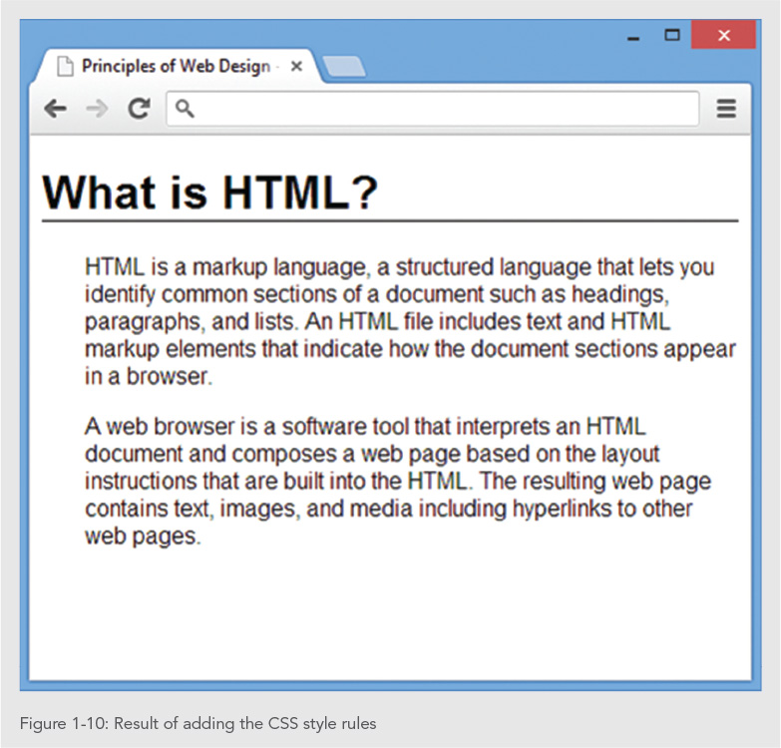

Slide 19
CSS Syntax
Style rules express style characteristics for an HTML element
For example, the following style rule sets all <p> elements to blue text:
P {color: blue;}
Style rules contain a selector and a declaration
You will learn more about CSS in Chapter 4

Slide 20
Organizing Information with Hypertext
The World Wide Web links information on related topics using hypertext
You determine which terms to create as hypertext links and where users end up when they click a link
The different types of linked content and media continually evolve

Slide 21
The History of HTML
As a web designer, you will encounter all types of HTML coding practices
Understanding the evolution of HTML will help you understand various web design methods
To be a successful web designer, you need to understand the past, present, and future directions of HTML, coding standards, and common practices

Slide 22
The History of HTML
Tim Berners-Lee first proposed HTML at the European Laboratory for Particle Physics (CERN) in 1989
Berners-Lee joined the ideas of the browser, a markup language (HTML), and a communications protocol that allowed hypertext linking
Not only could people read documents, they could easily create them using HTML

Slide 23
The History of HTML
HTML is an application of the Standard Generalized Markup Language (SGML), a standard system for specifying document structure
Berners-Lee joined the ideas of the user interface (browser), a markup language (HTML), and a communications protocol (http:) that allowed hypertext linking

Slide 24
A Need for Standards
The World Wide Web Consortium (W3C) was founded in 1994 MIT
The World Wide Web Consortium sets standards for HTML and other markup languages
Jointly developed standards, rather than ones dictated by one vendor, benefit everyone

Slide 25
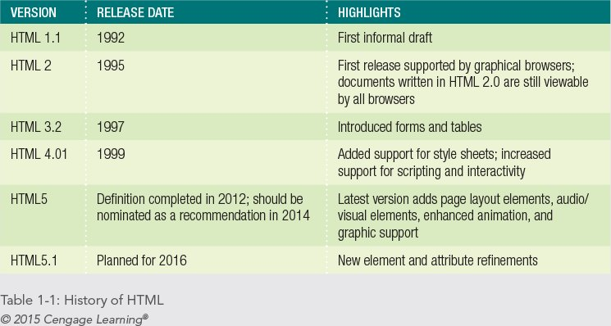
A Need for Standards

Slide 26
XML and XHTML – A New Direction
In 1997, the W3C released XML, the Extensible Markup Language
XML is essential to creating applications for the web
XML lets developers define their own markup language
XML has a stricter syntax than HTML

Slide 27
XML Syntax Rules
Documents must be well-formed
All tags must nest properly and not overlap
Use all lowercase for element names
Always use closing tags
Empty elements are signified by a closing slash
Attribute values must be contained in quotation marks

Slide 28
Sample XML
<poem>
<title>An Ode to the Web</title>
<stanza>
<line>So many web sites</line>
<line>So little time</line>
<line>And all I want to do</line>
<line>Is critique their design!</line>
</stanza>
</poem>

Slide 29
XML and XHTML – A New Direction
XML syntax provides a solution to the problem of widely varying HTML coding standards
The W3C combined XML and HTML to create XHTML
XHTML follows the rules of XML
Web developers readily adopted XHTML and CSS to standardize coding
Many web sites benefited from leaner standardized code

Slide 30
Problems with XHTML
Relaxed syntax rules still must be applied because of legacy code
Newer versions of XHTML moved too far away from existing web development
XHTML was not well received by the development community

Slide 31
A Proposal for HTML5
The Web Hypertext Application Technology Working Group (WHATWG) proposed HTML5
HTML5:
Supports standards-based coding
Compatible with HTML and XHTML
Compatible with CSS
Supports new page layout elements
Application and media compatible

Slide 32
Working with HTML5
HTML5 attempts to address shortcomings of HTML
Logical sectioning elements
Rich media
Support for applications
Removes old features:
All display elements have been removed in favor of CSS
Framesets are gone

Slide 33
Working with HTML5
HTML5 looks almost exactly like previous versions of HTML
The HTML5 <!DOCTYPE> statement is less complicated than in previous versions of HTML
The <meta> element specifies the document content type and character set. Many pages leave out this critical piece of information that tells the browser how to correctly interpret your HTML code

Slide 34
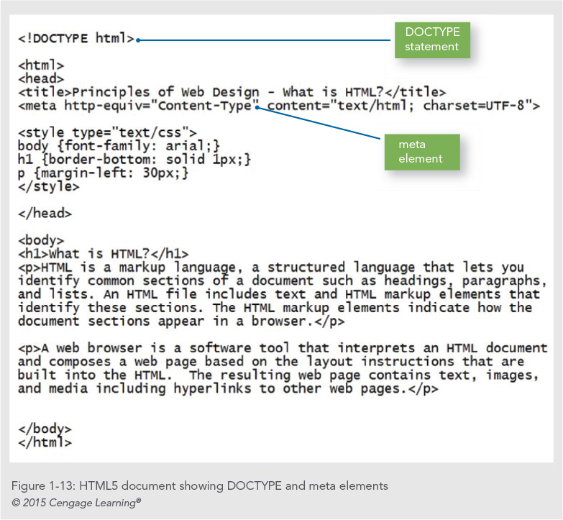

Slide 35
Working with HTML5
HTML5 offers two syntaxes:
An HTML-compatible syntax
An XML-compatible syntax
HTML-compatible syntax
More relaxed syntax
Code shortcuts allowed
XML-compatible syntax
Consistent with XHTML
Uses XML syntax rules

Slide 36
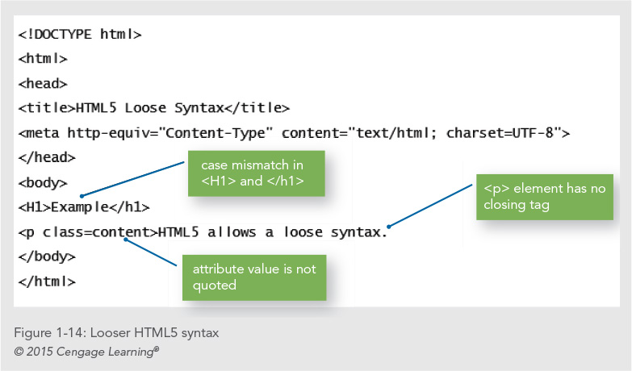

Slide 37
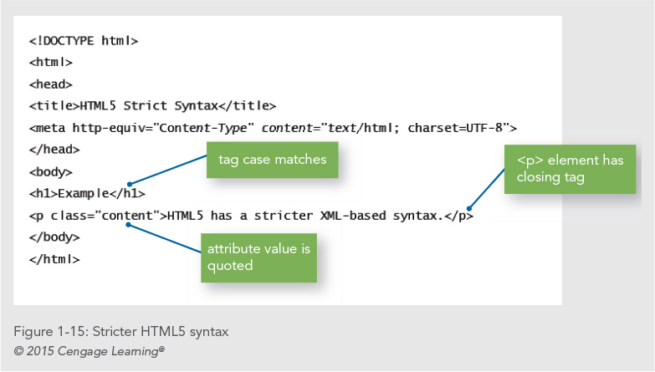

Slide 38
Choosing the Correct Syntax
It is a best practice to code using syntax that follows the stricter syntax rules, which are based on XML rules
The code you create for web content can have multiple purposes and potentially be used in a variety of display and application environments

Slide 39
Choosing the Correct Doctype
Always use a doctype statement
Using a doctype forces the browser to display in standards mode
The standard doctype statement for HTML5:
<!DOCTYPE html>

Slide 40
Choosing the Correct MIME type
Multipurpose Internet Mail Extensions (MIME) defines content types for the web
Determines the type of document
Declared in a <meta> element in the <head> section
Also contains a character set identifier
Your <meta> element should look like this:
<meta http-equiv="Content-Type" content="text/html; charset=utf-8">

Slide 41
Creating Syntactically Correct Code
Documents must be well-formed
All tags must nest properly and not overlap
Use all lowercase for element names
Always use closing tags
Empty elements are marked with a closing slash
Attribute values must be contained in quotation marks

Slide 42
HTML5 Element Categories
Metadata content
Flow content
Sectioning root
Sectioning content
Heading content
Phrasing content
Embedded content
Interactive content
Transparent

Slide 43
New Elements in HTML5
HTML5 has a number of new elements; see Table 1-2 in the text
All elements are supported by all modern browsers

Slide 44
Attributes in HTML5
Elements can contain attributes that set properties
Earlier versions of HTML had more attributes
HTML5 has less attributes because of CSS
Global attributes can be applied to any element

Slide 45
Obsolete Elements in HTML5
Many elements have been removed in HTML5, mostly involving presentation effects
Framesets are no longer available

Slide 46
Using HTML5 Elements for Page Structure
Most web pages contain common characteristics:
Header
Navigation
Articles
Figures
Footers
Sidebars
Until recently, most web pages were marked up with <div> elements and id or class names

Slide 47
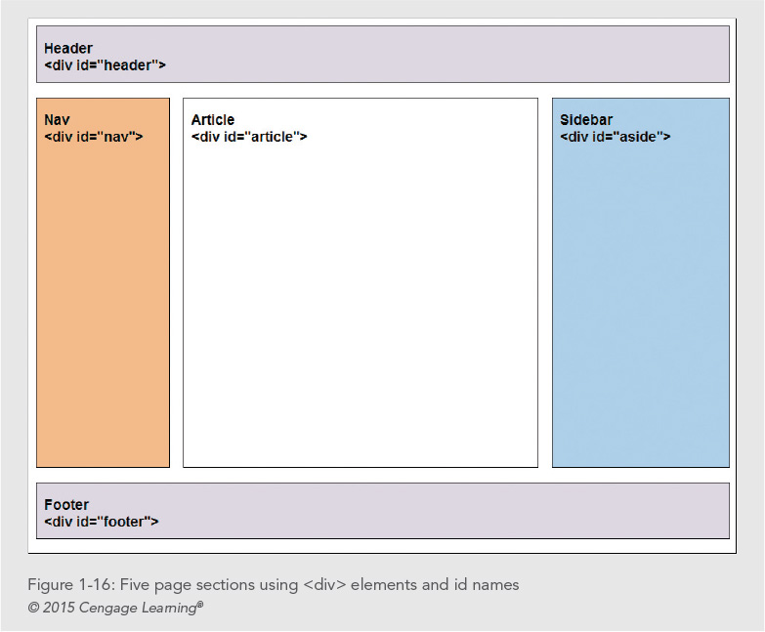

Slide 48
Using HTML5 Elements for Page Structure
The HTML5 elements for page layout include:
<header> Contains the page header content
<nav> Contains the navigation elements for the page
<article> Contains the primary page content
<section> Defines sections or groupings of page content
<aside> Contains additional content such as a quote or sidebar
<figure> Contains images for the article content
<footer> Contains page footer content

Slide 49
Using HTML5 Elements for Page Structure
HTML5 offers a new set of elements for describing document structure
HTML5 replaces the use of <div> with named elements to structure the page
The <article> element can be used instead of the <div> element, for example:
<article>This is the main content of the web page</article>

Slide 50
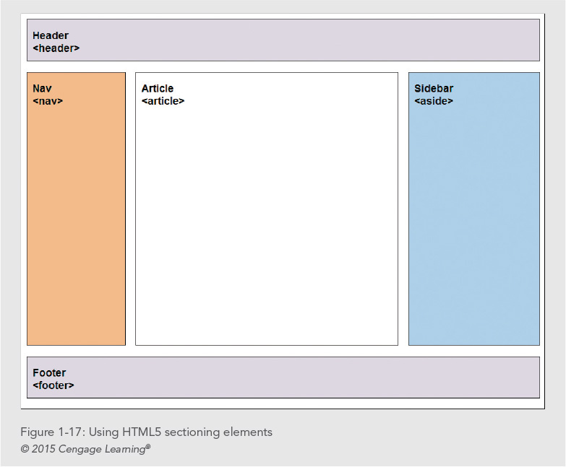

Slide 51
Interactive Capabilities in HTML5
Audio and video
Drawing canvas
Background application processing
Local data storage

Slide 52
Using Good Coding Practices
Creating code that ensures the greatest standards-compliance, presentation, and usefulness of your content
Stick to the standards
Use semantic markup
Validate your code

Slide 53
Stick to the Standards
Stick to the W3C standards
Separate content from presentation
Plan to be accessible to different devices
Standardized design is more accessible

Slide 54
Use Semantic Markup
Semantic markup identifies the intended use of document sections
Accurately describes each piece of content
Until recently, this logical use of the HTML elements was largely ignored
Document elements match the meaning and usage of the document sections: <p> for paragraph, <h1> for top-level heading, and so on

Slide 55
Validate Your Code
Valid code conforms to the usage rules of the W3C
The lack of valid code is a major problem
Valid code enhances browser compatibility, accessibility, and exchange of data
The most common mistakes include:
No doctype declaration
Missing closing tags
Missing alt attributes in <img> elements
Incorrect tag nesting
Unquoted attributes

Slide 56
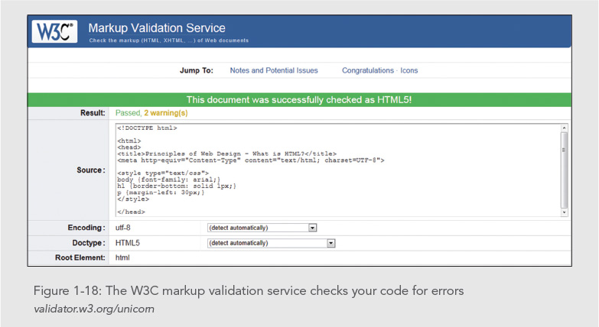

Slide 57
Summary
Make sure to check for support of new HTML5 elements
Use Cascading Style Sheets
Code to the stricter HTML5 standard
Use good coding practices
Use semantic markup

